Slide 1
CSCE 1035 Computer Programming I Chapter 7 Strings
University of North Texas

Slide 2

7.1 String Slicing

Slide 3

Selecting Characters from a String
A string is an ordered collection of characters
The character positions are identified by an index beginning at 0
If string str is initialized as str = 'hello, world', the characters in str would be arranged as follows
You can select an individual character using the syntax str[k], where k is the index of the desired character
You can also specify a character position in a string by using negative indexing, which counts backwards from the end of the string
The expressions str[7] and str[-5] both return the one-character string 'w' that appears at index 7 or -5
h
e
l
l
o
,
w
o
r
l
d
0
1
2
3
4
5
6
7
8
9
10
11
-12
-11
-10
-9
-8
-7
-6
-5
-4
-3
-2
-1

Slide 4
String Slicing
You can extract a substring by specifying a range of index positions inside the square brackets known as slicing
The simplest specification of a slice is [start:limit], where start is the index position where the slice begins and limit is the index position before the slice ends
The start and limit components of a slice are optional, but the colon : must be present
If start is missing, it defaults to 0
If limit is missing, it defaults to the length of the string
A slice specification may also contain a third component called a stride, as with [start:limit:stride]
A stride indicates how many positions are omitted between selected characters
The stride component can be negative, in which case the selection occurs backwards from the end of the string

Slide 5
String Slicing Example
Consider a string ALPHABET initialized as
ALPHABET = 'ABCDEFGHIJKLMNOPQRSTUVWXYZ'
so that the index numbers (in both directions) appear as follows
What are the values of the following slice expressions?
ALPHABET[7:9] ALPHABET[1:-1]
ALPHABET[-3:-1] ALPHABET[0:5:2]
ALPHABET[:3] ALPHABET[::-1]
ALPHABET[-1:] ALPHABET[5:2:-1]
ALPHABET[14:-12] ALPHABET[14:10:-2]
A
B
C
D
E
F
G
H
I
J
K
L
M
N
O
P
Q
R
S
T
U
V
W
X
Y
Z
0
1
2
3
4
5
6
7
8
9
10
11
12
13
14
15
16
17
18
19
20
21
22
23
24
25
-26
-25
-24
-23
-22
-21
-20
-19
-18
-17
-16
-15
-14
-13
-12
-11
-10
-9
-8
-7
-6
-5
-4
-3
-2
-1

Slide 6
7.2 Advanced String Formatting

Slide 7
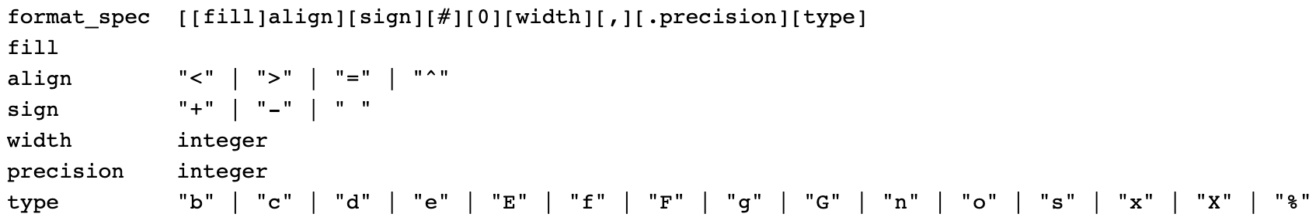
Python Format Specification
Format strings contain replacement fields surrounded by curly braces {}
Anything that is not contained in the braces is considered literal text that is copied unchanged to the output
The grammar for a replacement field is
"{" [field_name] ["!" conversion] [":" format_spec] "}"
The general form of a standard format specifier is
The full specification gives details about replacement fields
https://docs.python.org/3/library/string.html

Slide 8
Python Format Specification (cont’d)
fill defines the fill character used when displaying data that is too small to fit within the assigned space
align specifies the alignment of data within the display space
'<' left aligned
'>' right aligned
'=' justified
'^' centered
The formatting specification elements must appear in the correct order or Python won’t know what to do with them

Slide 9
Python Format Specification (cont’d)
sign determines the use of signs for the output
'+' positive numbers have a plus sign and negative numbers have a minus sign
'-' negative numbers have a minus sign
' ' positive numbers are preceded by a space and negative numbers have a minus sign
'#' specifies that output should use alternative display for numbers
For example, hexadecimal numbers will have the 0x prefix

Slide 10
Python Format Specification (cont’d)
'0' specifies that output should be sign aware and padded with zeros as needed to provide consistent output
width determines the full width of the data field (even if the data won’t fit in the space provided)
',' specifies that numeric data should have commas as a thousands operator
.precision determines number of characters after the decimal point

Slide 11
Python Format Specification (cont’d)
type specifies the output type, even if the input type doesn’t match
String
Use an s or nothing at all to specify a string
Integer
b (binary), c (character), d (decimal), o (octal), x or X (hexadecimal), and n (locale-sensitive decimal)
Floating Point
e or E (exponent), f or F (fixed point), g or G (general format), n (locale-sensitive general format), and % (percentage)

Slide 12
7.3 String Methods

Slide 13
Replacing Substrings
Recall that strings are immutable, meaning that they cannot be changed once created
They can be discarded, however, with the variable name reassigned to another string
The general format for the string replace() method is
<string object>.replace(old, new[, count])
replace() returns a copy of string with occurrences of old replaced by new, limiting number of replacements to count
>>> str = 'That is fun!'
>>> id(str)
3080141664
>>> str = str.replace('is', 'was')
>>> print(id(str), str)
3079361624 That was fun!

Slide 14
Searching for Substrings
find() method searches for specified substring within string
Returns the index of the first occurrence of the substring, if found, or returns -1 otherwise
The general format for the string find() method is
<string object>.find(substring[, start[, end]])
where substring can be a string variable or literal, start is the starting index with a default of 0, and end is the ending index with a default equal to the length of the string (i.e., len(string))
index() works the same as find() method, except that it raises an exception if the substring does not exist
rfind() returns the last index where the substring is found, or -1 otherwise
count() returns number of times a substring occurs in string

Slide 15
Comparing Strings
Comparison between strings is typically performed character-by-character using the ASCII values
Criteria also includes character order and length of string
String objects can be compared using
Relational operators
< <= > >=
Equality operators
== !=
Membership operators (does substring exist in string?)
in not in
Identity operators (are strings bound to same object?)
is is not

Slide 16
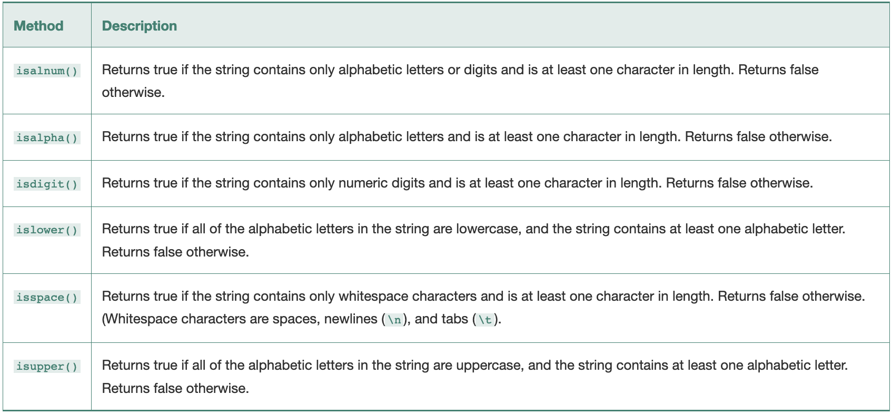
String Testing Methods
String methods can test a string for specific characteristics
Also test if a string startswith() or endswith() a specific value

Slide 17
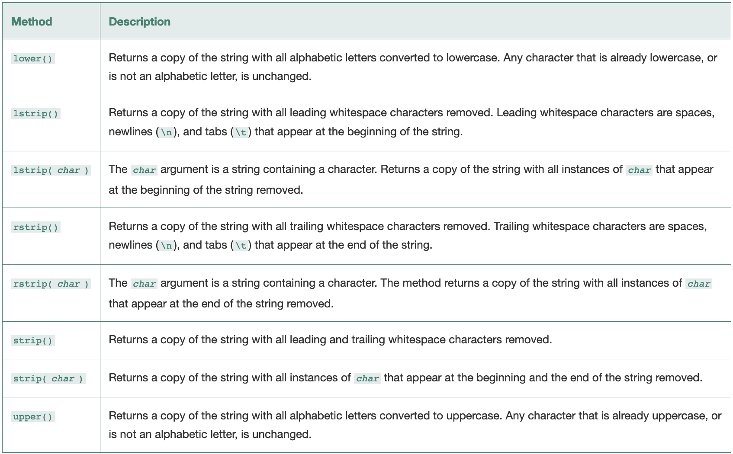
String Modification Methods

Slide 18
Available String Methods
>>> help(str)
>>> dir(str)
['__add__', '__class__', '__contains__', '__delattr__', '__dir__', '__doc__', '__eq__', '__format__', '__ge__', '__getattribute__', '__getitem__', '__getnewargs__', '__gt__', '__hash__', '__init__', '__init_subclass__', '__iter__', '__le__', '__len__', '__lt__', '__mod__', '__mul__', '__ne__', '__new__', '__reduce__', '__reduce_ex__', '__repr__', '__rmod__', '__rmul__', '__setattr__', '__sizeof__', '__str__', '__subclasshook__', 'capitalize', 'casefold', 'center', 'count', 'encode', 'endswith', 'expandtabs', 'find', 'format', 'format_map', 'index', 'isalnum', 'isalpha', 'isdecimal', 'isdigit', 'isidentifier', 'islower', 'isnumeric', 'isprintable', 'isspace', 'istitle', 'isupper', 'join', 'ljust', 'lower', 'lstrip', 'maketrans', 'partition', 'replace', 'rfind', 'rindex', 'rjust', 'rpartition', 'rsplit', 'rstrip', 'split', 'splitlines', 'startswith', 'strip', 'swapcase', 'title', 'translate', 'upper', 'zfill’]
>>> print(str.title.__doc__)
S.title() -> str
Return a titlecased version of S, i.e. words start with title case
characters, all remaining cased characters have lower case.
>>> callable(str.title)
True

Slide 19
7.4 Splitting and Joining Strings

Slide 20
Splitting a String
The split() method returns a list of tokens (such as words) that form a part of a larger string
The general format for the string split() method is
<string object>.split([separator][, maxsplit])
where separator specifies the delimiter to use when splitting the string, with a space being the default and maxsplit indicating how many splits to perform
Default value for maxsplit is -1, which means all occurrences
>>> str1 = 'Python is a lot of fun'
>>> list1 = str1.split()
>>> print(list1)
['Python', 'is', 'a', 'lot', 'of', 'fun']

Slide 21
Joining a String
The join() method performs the inverse of split() by joining a list of strings together to create a single string
The general format for the string join() method is
<string object>.join(iterable)
where the string object is used the separator and iterable is any iterable object where all the returned values are strings
>>> print(list1)
['Python', 'is', 'a', 'lot', 'of', 'fun']
>>> str2 = '#'.join(list1)
>>> print(str2)
Python#is#a#lot#of#fun

